Slide 1
German Credit Risk Analysis
Y Ramya Koteswari

Slide 2
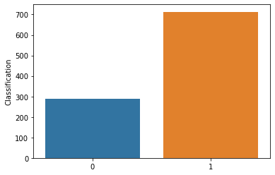
WHY CREDIT RISK ANALYSIS
Credit risk analysis is assessing the possibility of the borrower’s repayment failure and the loss caused to the financer when the borrower does not for any reason repay the contractual loan obligations.
BAD CREDIT RISK
GOOD CREDIT RISK

Slide 3
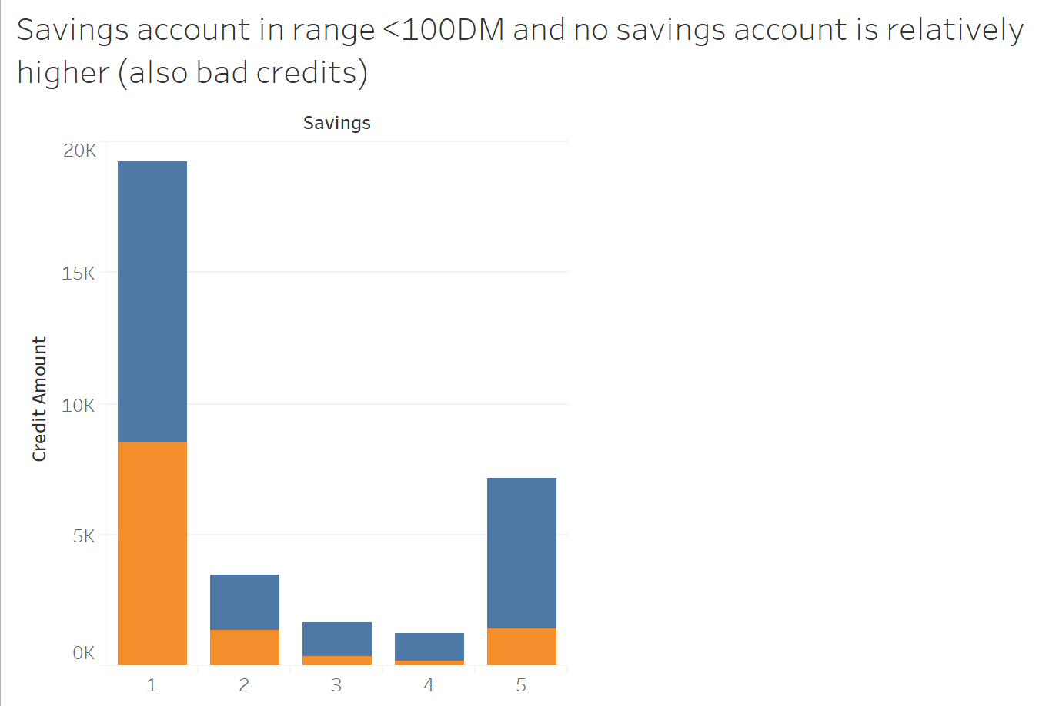
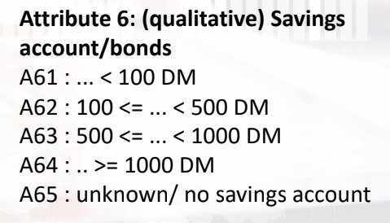
How SAVINGS and CREDIT AMOUNT are related
BAD CREDIT RISK
GOOD CREDIT RISK

Slide 4
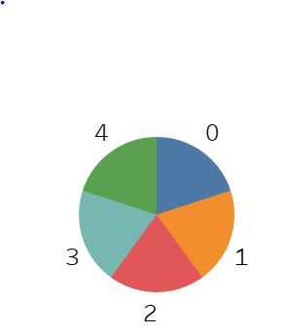
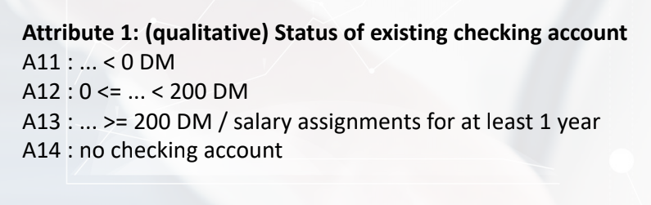
Credit History

Slide 5
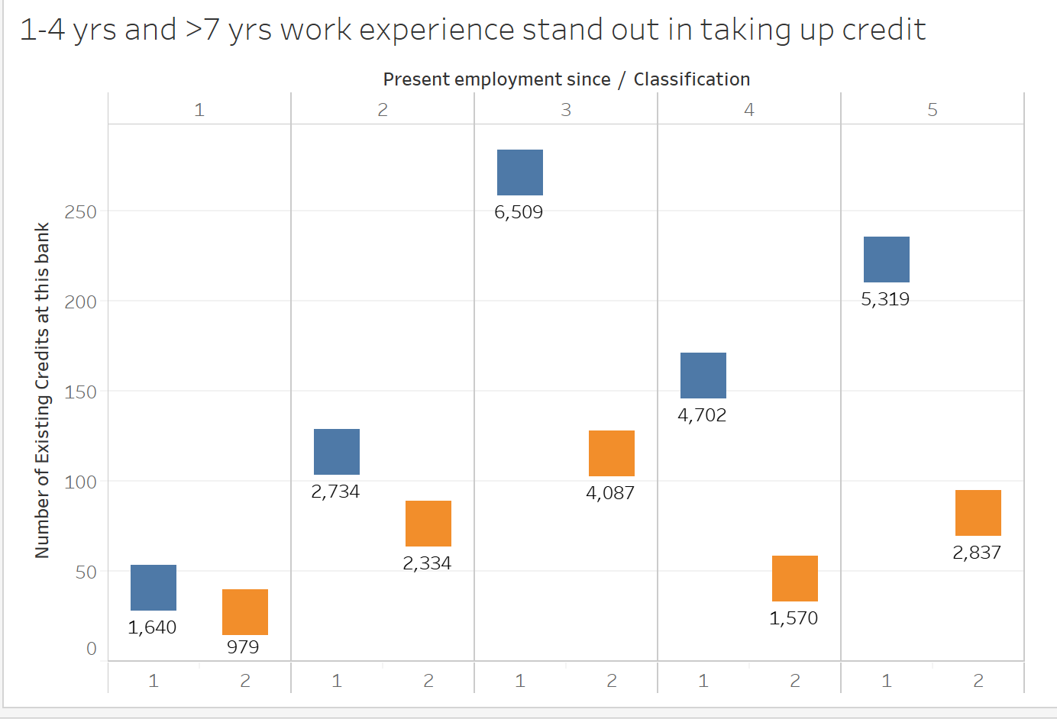
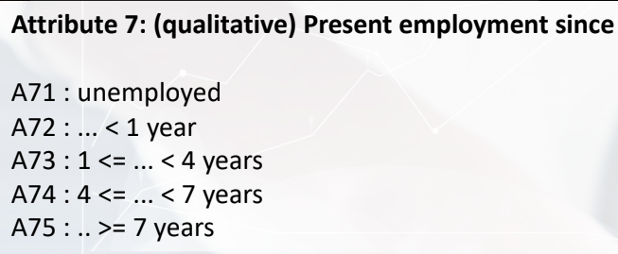
BAD CREDIT RISK
GOOD CREDIT RISK

Slide 6
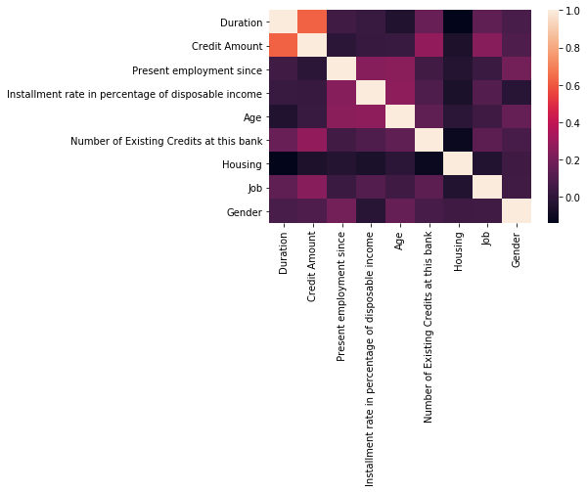
CORRELATION PLOT

Slide 7
PROBLEM STATEMENT
The German Credit data set is a publically available data set downloaded from the UCI Machine Learning Repository. The data contains data on 20 variables and the classification whether an applicant is considered a Good or a Bad credit risk for 1000 loan applicants.
The objective of this case study is to deploy different classification techniques and find out the best classification model.

Slide 8
Overall Performance of Models on Credit Risk
Models were applied on data obtained after cleaning
MODEL | DECISION TREE | BAGGING | RANDOM FOREST | ADA BOOSTING | XGBOOST | GRADIENT BOOSTING
ACCURACY SCORE | 98.85% | 98% | 98.5% | 96% | 98% | 97.5%

Slide 9
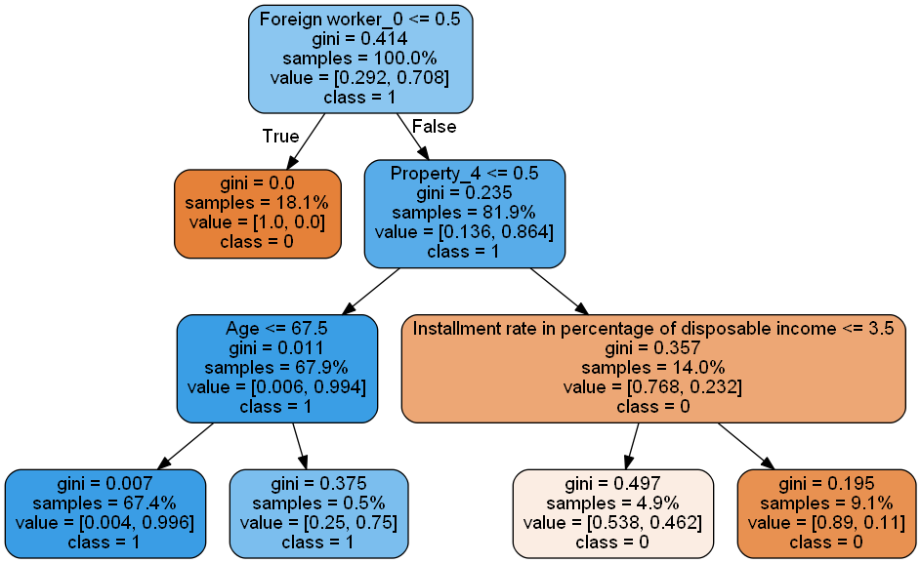
Decision Tree model
Is a foreign Worker
Has Property_4 =0
Age is less than 67.5
67.4% of the data falls under the above conditions
These customers turn out to contribute to good credit risk categories

Slide 10
IMPORTANT FEATURES
Foreign worker_0 : Is not a foreign worker
Property_4
Installment rate in percentage of disposable income
Age

Slide 11
THANK YOU

